Slide 1
DS17- 2024 BIU - University Advanced ML Course Guy Yarhi

Slide 2

Agenda
Familiar Guy Yarhi.
The advanced Machine Learning (ML) course at Bar Ilan University aimed to provide students with an in-depth understanding of complex ML concepts and techniques. The course was meticulously designed under the supervision of the High Tech School and highly educated staff, ensuring a comprehensive learning experience.

Slide 3
About Guy Yarhi
Guy Yarhi is a seasoned professional with extensive experience in research and development (R&D). His career began with the development of leading test engineering arrays and coding medical applications, adhering to stringent FDA and ISO regulations. Guy has successfully led project timelines and applied agile methodologies, effectively managing IT squads and ensuring project milestones are met.
He holds:
Bachelor of Science (BSc) in Electrical Engineering with a specialization in Embedded Computers
Master of Science (MSc) in Technological Management.
Now added an important certification:
Data Science and Machine Learning Advanced Certification from Bar Ilan University (DS 17- 2024).
Additionally, Guy has earned several important certifications, including:
Web Development from HIT.
Testing Principles from ISTQB.
His diverse skill set and certifications underscore his expertise in both technical and managerial aspects of technology and software development.

Slide 4
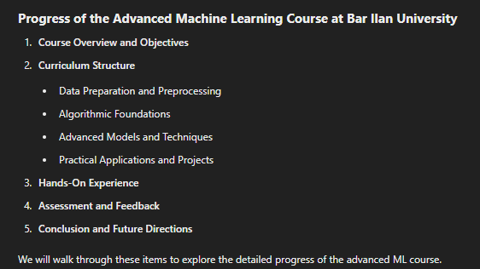
Course Overview and achievement

Slide 5
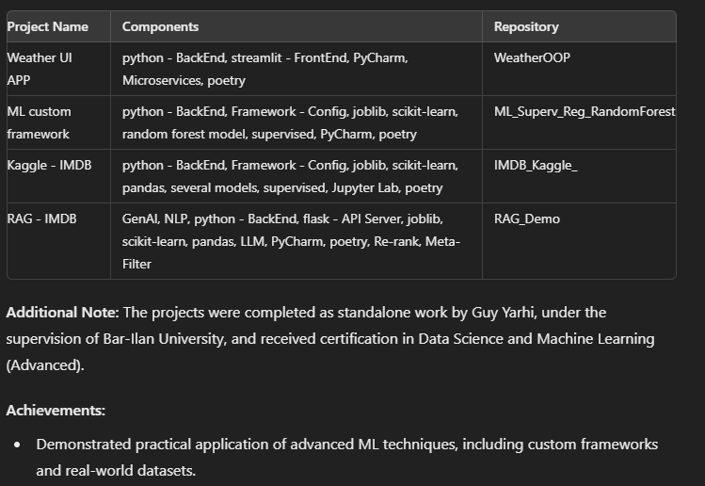

Additional Note:
The code and presentations for each project are available here:
https://github.com/GuyYar1.

Slide 6

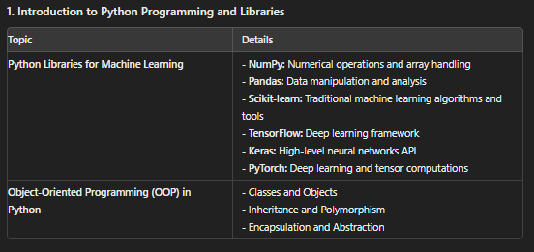
The power of communication

Slide 7
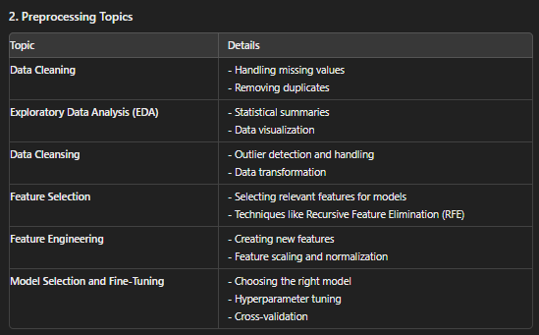

Slide 8
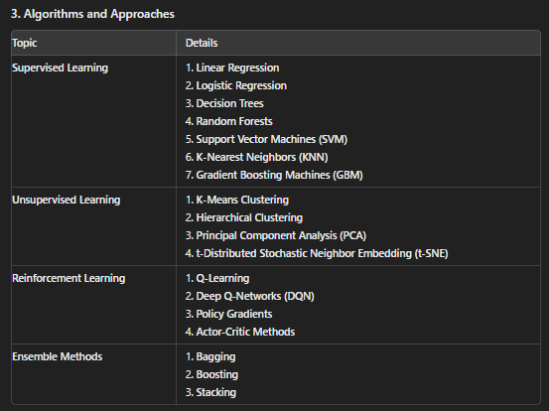

Slide 9
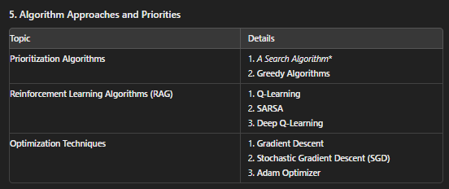

Slide 10
Thank you
Achievements:
All projects were completed as standalone work by
Guy Yarhi, under the supervision of Bar-Ilan University.
Each project received certification in Data Science and Machine Learning (Advanced) upon successful completion.
Demonstrated practical application of advanced ML techniques, including custom frameworks and real-world datasets.
Guy Yarhi

